Slide 1
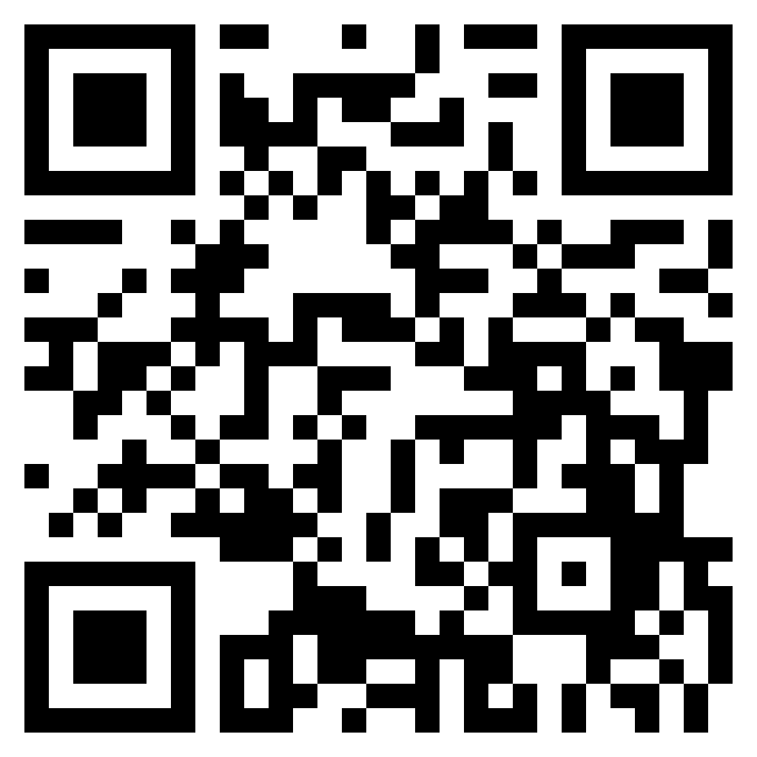
Debate Matters – the Art of Argument
Scan the QR code to Register
EVENT DETAIL:
Centre for Professional Enhancement is going to conduct “Debate Competition” Topics are given before hand. Students can register in team of 2. Best opportunity to showcase your speaking skills
Date: 20th April, 2023
Time: 5:00 PM Onwards
Venue: Block 14-501L
RESOURCE PERSON : Mr. Sapan

Slide 2
Scan ME – NOW!!

